Slide 1
html/javascript/css LESSONS
Elemental Elements

Slide 2
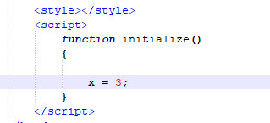
A simple variable
When you deal with a variable, it’s easiest to follow a variable that holds a single value.
If we want to manipulate our page dynamically, we need something more complex.

Slide 3
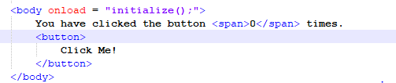
Something More
Here I have some HTML, telling me that I have clicked a button 0 times.
There’s also a button.

Slide 4

Something more

Slide 5
Something more
When we begin to think about how we want to update a page dynamically, we have to ask ourselves several questions:
What is the thing that we want to change?
Where is the thing that we want to change?
How can we access the thing that we want to change?

Slide 6
What is the thing that we want to change?
Almost always, what we want to change is some HTML element. We may want to change its text, its color, or its position.
In this case, we want to change some text.

Slide 7
where is the thing that we want to change?
Having the text that we want to change in its own element allows us to identify it apart from the rest of the text on the page.

Slide 8
How do we access the thing that we want to change?
Since HTML is nothing more than fancy text on a page, we need to access the element through Javascript in order to make it update dynamically.

Slide 9
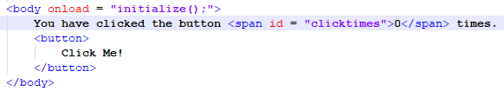
id
The first thing to do is to give your element an id attribute.
An id should have a unique value that is shared with no other element.
The value of an id should be a name that represents the purpose of the element.
All ids need to be unique to the system, so don’t get lazy with your names.
Your id is your pathway to Javascript access.

Slide 10
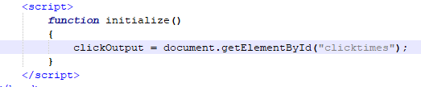
Something more
In order to work in Javascript (or any program language) we have to move information through variables (like our x from before).
Here, though, we need something much more complicated than a simple numerical value.

Slide 11
object
We need an object.

Slide 12
object
Creating and assigning the variable works the same way as any other variable. We give the variable a name and assign it a value using the assignment operator (=).

Slide 13
object
It’s the value we assign it that comes from a much more complicated place.

Slide 14
document
The document is an object that represents, well, your document.
This object stores all of the necessary information for your document, such as the height, the width, the number of HTML elements, etc… inside of it.
There are also things that you can do with it, represented by functions.

Slide 15
getelementbyid
An object accesses its variables and functions through the use of a dot (.).
getElementById is a function that belongs to the document. It searches the entire document for an element until it finds one with a specified id.
That id is passed into the function as an argument.

Slide 16
The element as a javascript variable
When it finds the element with the specified id, it returns that element.
The best thing to do with this returned element is to store it in a variable, as we do here.

Slide 17
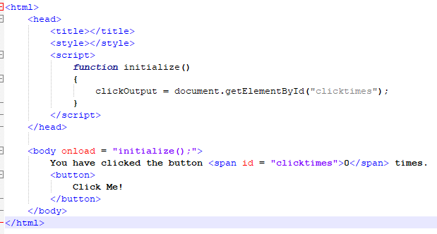

Slide 18
The element as a javascript variable
The clickOutput variable is the HTML element.

Slide 19
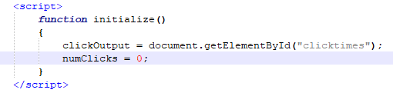
The element as a javascript variable
We will ultimately use that variable to display our number of clicks, represented by the numClicks variable, on the screen.

Slide 20

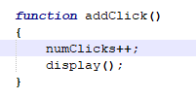
onclick
By adding an onclick event to the HTML button, we can call the Javascript function that adds 1 to the number of clicks.
After updating the back end variable, we move on to the display function so that we can see the output.

Slide 21

display
As an object, the clickOutput variable has its own set of variables and functions (just like document does).
In order to update the text between the opening and closing tags, we access innerHTML.

Slide 22
innerhtml
innerHTML is a string property that exists in every HTML Element with an opening and closing tag.
<br />, <hr />, <img /> and other self closing tags do not have innerHTML.
You can assign any text you want to innerHTML and it will appear on screen.
We want to show the number of clicks of the button.

Slide 23
Page Sequence
Follow the sequence of this program:
The page loads
All of the written HTML appears on screen.
Initialize() is called, creating clickOutput and assigning it the <span> element and numClicks and assigning it a 0.
The page waits for the user to click the button…
The button is clicked.
The addClick function is called, adding 1 to the numClicks variable and calling display() function.
The innerHTML of clickOutput is given the value held in numClicks.
Step 3 is repeated an unknown number of times.

